Slide 1

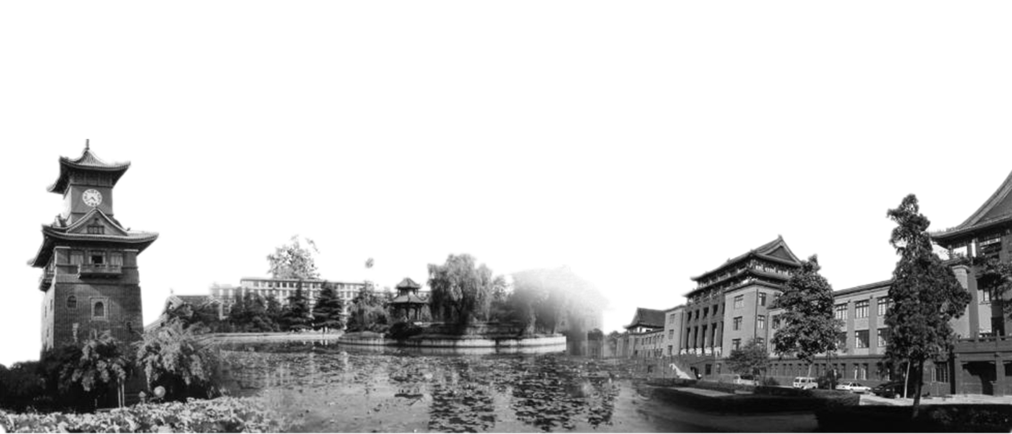

Mastering the game of Go
without human knowledge
Group member： 沈硕 夏榕 王洪森 江佩东

Slide 2

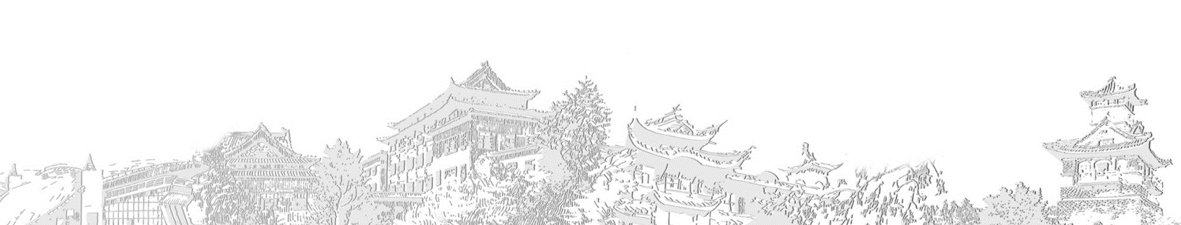
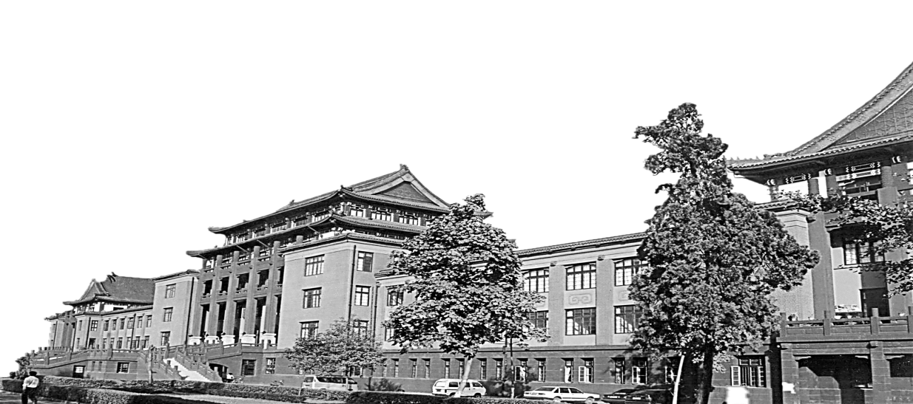
AlphaGo Zero
winning 100–0 against the previously published, champion-defeating AlphaGo.

Slide 3
AlphaGo Zero
1. Only use the most basic features as input
2. Training based on self reinforce learning without human experience
3. Only use a single neural network structure instead of Policy network and Value network
Notes:
Which means, the model only know the basic rule ,
Consider a lot of terms in human Go theory

Slide 4
AlphaGo Zero
4. Simplified the Monte Carlo Tree Search (MCTS) and abandoned Rollout Policy

Slide 5
AlphaGo Zero
At each step of selfplay, the move probability is calculated from the deep neural network, then we use the MCTS (Monte Carlo search) to improve our strategy

Slide 6
MCTS(Monte Carlo Tree Search)
The focus of Monte Carlo tree search is on the analysis of the most promising moves, expanding the search tree based on random sampling of the search space. The application of Monte Carlo tree search in games is based on many playouts. In each playout, the game is played out to the very end by selecting moves at random. The final game result of each playout is then used to weight the nodes in the game tree so that better nodes are more likely to be chosen in future playouts.

Slide 7
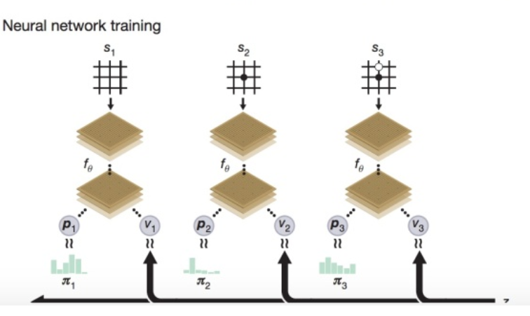
Neural Network

Slide 8
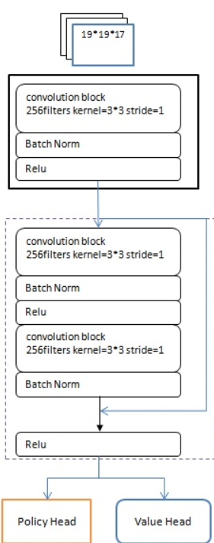

Neural Network
19x19x17
Input:
Position s
Output:

Slide 9
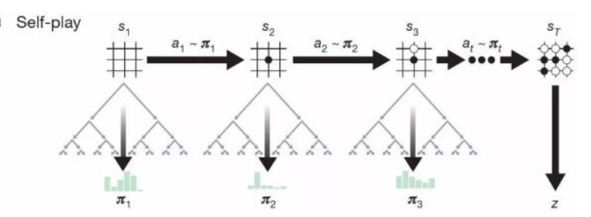
Self Play

Slide 10

Loss Function
Notes:
Reduce the error

Slide 11
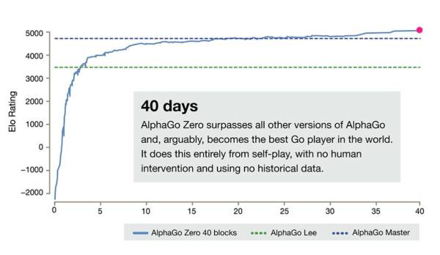
Result
Notes:
1. Since we frame detection as a regression problem we don’t need a complex pipeline. We simply run our neural network on a new image at test time to predict detections.
2. YOLO makes less than half the number of background errors compared to Fast R-CNN
3. Since YOLO is highly generalizable it is less likely to break down when applied to new domains or unexpected inputs.

Slide 12
Summary
AlphaGo Zero is a brand new model to solve Go problem without human knowledge. This model is based on the MCTS and deep neural network. Compared with AlphaGo, it has simplified the part of supervised learning with the games of human expert. This model has also simplified the structure of neural network and MCTS. The new reinforcement learning algorithm repeatedly use the Strategy Evaluation operator to iteratively update neural network strategy. In each step, the move probability is calculated from the deep neural network, then we use the MCTS (Monte Carlo search) to improve our strategy. This model is a revolutionary improvement to AlphaGo. It abandoned the concept and knowledge of human in the past thousands of years and got excellent result.
Notes:
1. Since we frame detection as a regression problem we don’t need a complex pipeline. We simply run our neural network on a new image at test time to predict detections.
2. YOLO makes less than half the number of background errors compared to Fast R-CNN
3. Since YOLO is highly generalizable it is less likely to break down when applied to new domains or unexpected inputs.

Slide 13



T | H | A | N | K |  | Y | O | U
Designed By Yang Dexing, Sichuan University 欢迎使用

